Slide 1
Contour Integration

Slide 2
Evaluation of Definite Integrals
Trigonometric Integrals, Range (0,2π)
f = rational function & finite everywhere
Set →
∴
C = unit circle at z = 0.
z_{j} = poles inside C

Slide 3
Example Integral of cos in Denominator
inside
outside
→ Poles at
C
∴

Slide 4
Another Trigonometric Integral
Only poles at 0 & ½ are inside C.

Slide 5
→

Slide 14
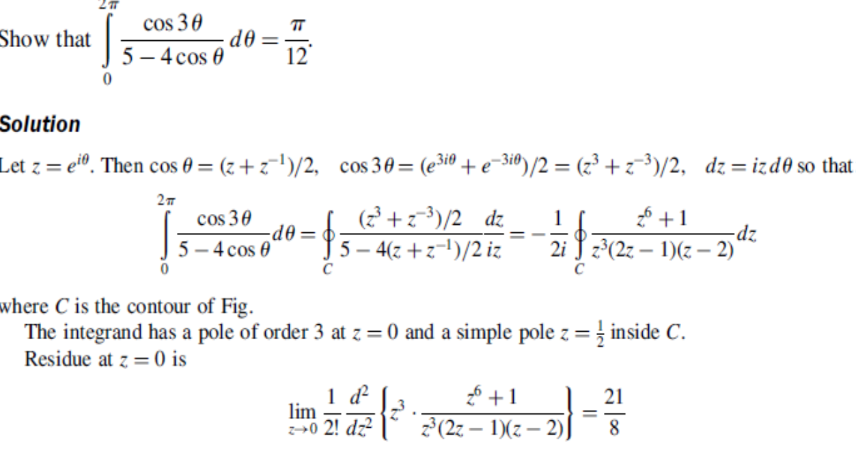

Slide 16
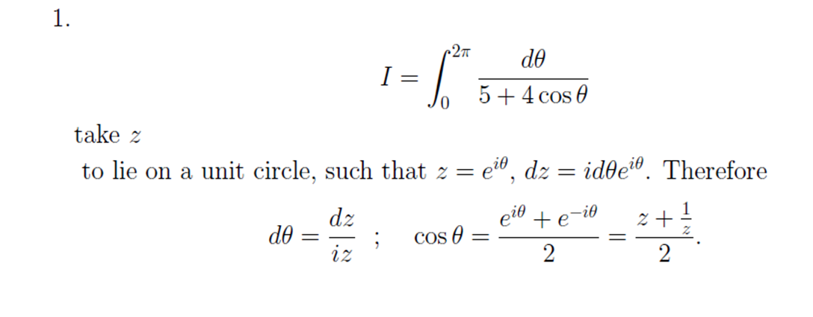

Slide 19
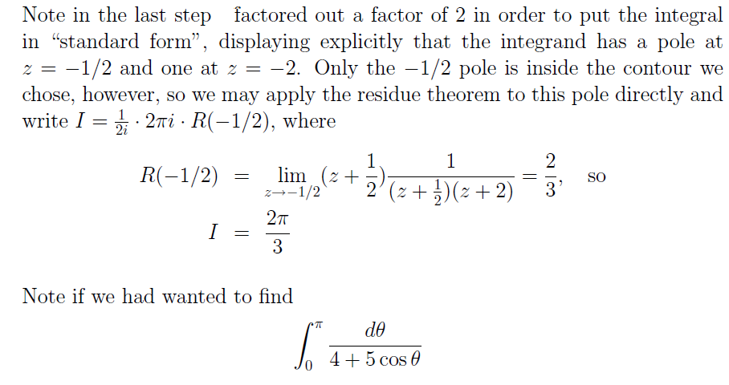

Slide 20
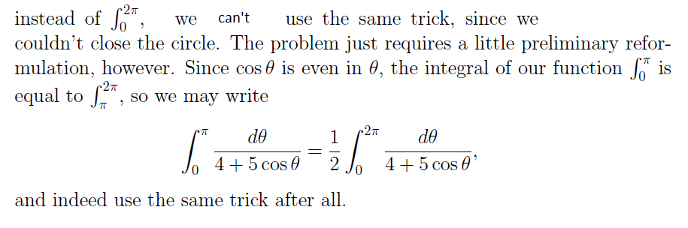

Slide 21
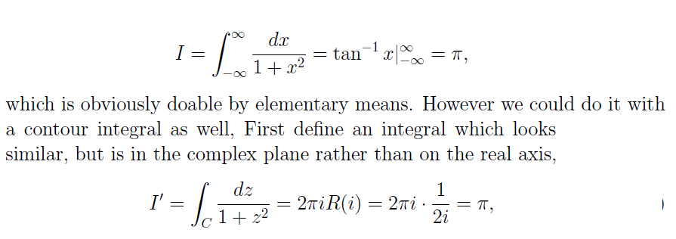

Slide 23
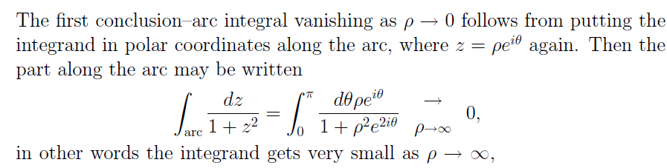

Slide 24
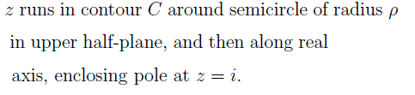

Slide 25
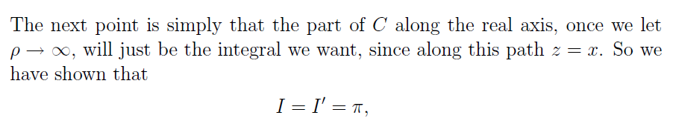

Slide 29
